Slide 1
History of Mario
By, Michael Weyman

Slide 2
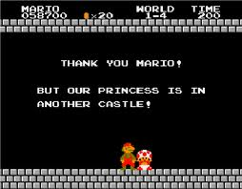

Slide 3
Story of Mario

Slide 4
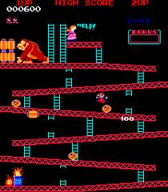
First appearance!
Donkey Kong (1981)
He was a nameless character later known as jumpman

Slide 5
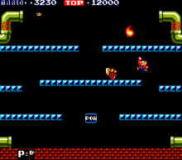
First Game
Mario Bros (1983)
First appearance of Luigi
arcade game

Slide 6
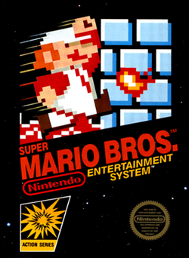
Becoming a sidescroller
Super Mario Bros. (1985)
Power ups introduced
Story first introduced
2 sequels released in 1988
Super Mario World
Yoshi introduced

Slide 7
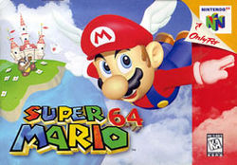
RPG/Platformer
First appearance in 3D
Super Mario RPG (1996)
RPG not very popular
N64 allows better graphics
Super Mario 64 (1996)
Super Mario Sunshine (2002)

Slide 8
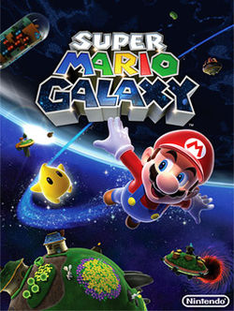
Mario In Space
Super Mario Galaxy (2007)
Applying physics of space to the game

Slide 9
Conclusion!

Slide 10
Bibliography!
http://en.wikipedia.org/wiki/Mario

